Slide 1

Sequence of words in audio form
(input)
ML Model
Sequence of words in TEXT form
(Output)
How to convert Speech to Text e.g Alexa, Siri

Slide 2
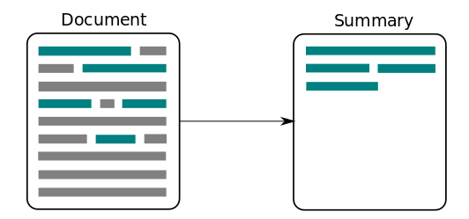
How to summarize text?
Large sequence of words
(input)
ML Model
Small sequence of words
(Output)

Slide 3
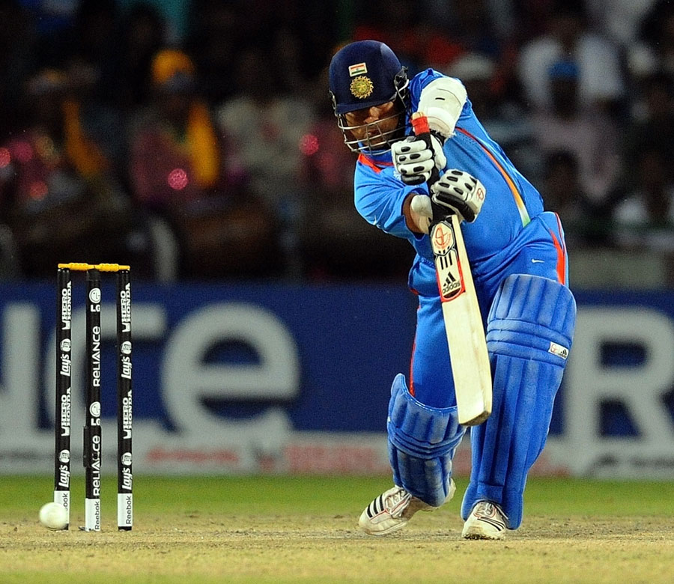
How to describe a picture?
Sequence of pixels (images)
ML Model
Sequence of words
(Output)
Tendulkar playing cricket

Slide 4
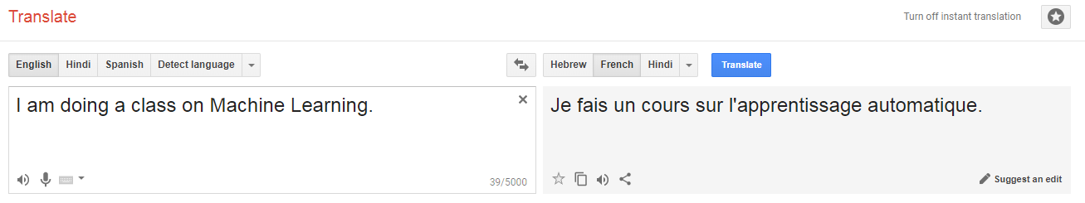
How to translate?

Slide 5
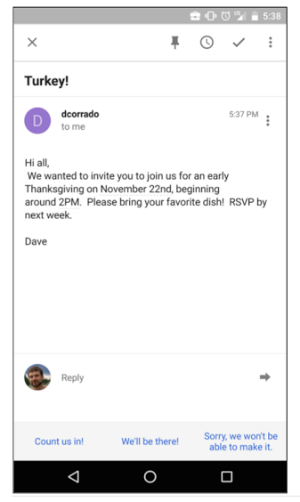
How to provide a response to Email?
Suggested Answers

Slide 6

How do we build models which convert …
a sequence into another sequence?

Slide 7

Understanding
Language Translation

Slide 8
Sequence of words in source language
(input)
Sequence of words in target language
(output)

Slide 9
Encoder
Input Sequence
Sequence Embedding
Recurrent Neural Network
“Let’s”
“go”
“to”
“Delhi”
0.9512
0.0377
0.4927
0.6106
RNN’s
Memory or State
Learning the input sequence
LSTMs are quite good at understanding a sequence

Slide 10
Encoder
Input Sequence
Sequence Embedding
Recurrent Neural Network
“Let’s”
“go”
“to”
“Delhi”
0.9512
0.0377
0.4927
0.6106
How do we generate the Output sequence from Sequence Embedding?

Slide 11
Input Sequence
Encoder
Decoder
Output Sequence
Sentence Embedding
“Let’s”
“go”
“to”
“Delhi”
Recurrent Neural Network
Recurrent Neural Network
“आओ” “हम”
“दिल्ली” “जाएं”
0.9512
0.0377
0.4927
0.6106
We use another RNN . .

Slide 12
Input Sequence
Encoder
Decoder
Output Sequence
Sentence Encoding
“Let’s”
“go”
“to”
“Delhi”
Recurrent Neural Network
Recurrent Neural Network
“आओ” “हम”
“दिल्ली” “जाएं”
0.9512
0.0377
0.4927
0.6106
Sequence to Sequence (Seq2Seq) Model

Slide 13
Why this is a powerful idea?

Slide 14
No need to know any rule about human language.
Achieved better results than 20 years of work with Statistical Machine translation.
Neural Machine Translation (NMT)

Slide 15
Building Seq2Seq Model in Keras
Input Sentence
Encoder
Decoder
Output Sentence
Output Encoding
“Let’s”
“go”
“to”
“Delhi”
Recurrent Neural Network
Recurrent Neural Network
“आओ” “हम”
“दिल्ली” “जाएं”
0.9512
0.0377
0.4927
0.6106

Slide 16

www.manythings.org/anki
Pick any language combination
Collect Translation Data

Slide 17
Data Processing

Slide 18
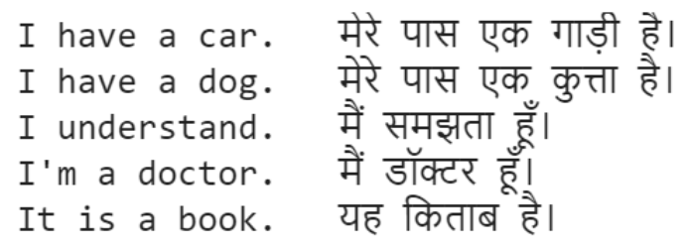
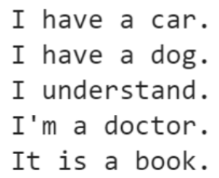
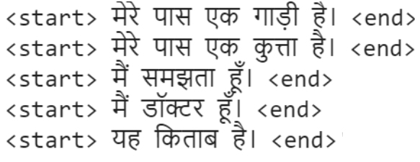
Source Language Data
Raw Data (Language Pairs)
Target Language Data
For target sequence, we will use a start sequence and end sequence (useful during prediction)

Slide 19
Source Language Data
Tokenize
(Convert into Numbers)
Raw Data (Language Pairs)
What is the length of each sentence?
Target Language Data
Tokenize
(Convert into Numbers)

Slide 20
Source Language Data
Tokenize
(Convert into Numbers)
Pad Sequences
Raw Data (Language Pairs)
Target Language Data
Tokenize
(Convert into Numbers)
Pad Sequences
Make all sentences of same size!

Slide 21
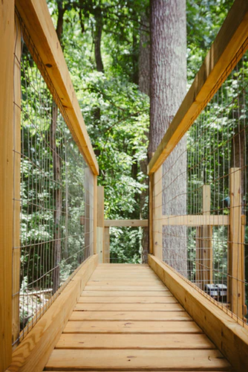
Building
Seq2Seq Model

Slide 22
यह किताब है।
Target language words
In this approach, decoder struggles to give good output
Encoder
Decoder
Source language sequences
Sentence Embedding
It is a book.
(as numbers)
Seq2Seq Model

Slide 23
यह किताब है। <end>
Target language words
(Shifted by one time step)
Seq2Seq Model (Modified)
Encoder
Decoder
Source language sequences
Sentence Embedding
It is a book.
(as numbers)
Target language sequences
To improve Decoder output, target output is also fed as an input
<start> यह किताब है। <end>
(as numbers)

Slide 24
यह किताब है। <end>
Target language words
(Shifted by one time step)
Let’s understand size of inputs and outputs for this model
Encoder
Decoder
Source language sequences
Sentence Embedding
It is a book.
(as numbers)
Target language sequences
Seq2Seq Model (Modified)
<start> यह किताब है। <end>
(as numbers)

Slide 25
यह किताब है। <end>
How many numbers do we need as an output?
Target language words
(Shifted by one time step)
Input #1
Numbers equal to max sentence length of source language
Encoder
Decoder
Source language sequences
Sentence Embedding
It is a book.
(as numbers)
Target language sequences
Seq2Seq Model
Input #2
Numbers equal to max sentence length of target language
<start> यह किताब है। <end>
(as numbers)

Slide 26
यह किताब है। <end>
1. How many words do we need to Predict?
As many as max sequence length for target
2. How many numbers to predict for one word?
As many as vocab size for target language
Target language words
(Shifted by one time step)
Input #1
Numbers equal to max sentence length of source language
Encoder
Decoder
Source language sequences
Sentence Embedding
It is a book.
(as numbers)
Target language sequences
Seq2Seq Model
Input #2
Numbers equal to max sentence length of target language
<start> यह किताब है। <end>
(as numbers)

Slide 27
यह किताब है। <end>
Output Size?
Target language words
(Shifted by one time step)
Input #1 Size?
Encoder
Decoder
Source language sequences
Sentence Embedding
It is a book.
(as numbers)
Target language sequences
Seq2Seq Model
(Fill up the numbers for current example)
Input #2 Size?
<start> यह किताब है। <end>
(as numbers)

Slide 28
यह किताब है। <end>
How many actual label values for each example?
Same as the output size
(in the form of one hot encoding)
Loss
Target language words
(Shifted by one time step)
Actual Labels
Encoder
Decoder
Source language sequences
Sentence Embedding
It is a book.
(as numbers)
Target language sequences
Seq2Seq Model
<start> यह किताब है। <end>
(as numbers)

Slide 29
यह किताब है। <end>
Optimizer
Loss
Target language words
(Shifted by one time step)
Update
Weights
Actual Labels
Encoder
Decoder
Source language sequences
Sentence Embedding
It is a book.
(as numbers)
Target language sequences
Seq2Seq Model
<start> यह किताब है। <end>
(as numbers)

Slide 30
Building Decoder Output Data
We will use one hot encoding as actual label for each output word

Slide 31
यह किताब है। <end>
Building Encoder Model
Target language words
(Shifted by one time step)
Encoder
Decoder
Source language sequences
Sentence Embedding
It is a book.
(as numbers)
Target language sequences
<start> यह किताब है। <end>
(as numbers)

Slide 32
Padded Input Sequences
What should be the first layer?
It is a book.
[0, 0, 0, . . .11, 5, 6, 70]
(22 Numbers)
Encoder

Slide 33
Embedding Layer
Padded Input Sequences
It is a book.
Encoder

Slide 34
Embedding Layer
Padded Input Sequences
What should be the Next layer?
It is a book.
Encoder

Slide 35
Embedding Layer
We will use LSTM to understand input sequence
Padded Input Sequences
LSTM
It is a book.
Encoder

Slide 36
Embedding Layer
Padded Input Sequences
LSTM
C
LSTM
C
LSTM
LSTM
C
h
h
h
It is a book.
[0, 0, 0, . . .11, 5, 6, 70]
(22 Numbers)
What is the value Sentence Embedding?
Encoder

Slide 37
यह किताब है। <end>
Building Decoder Model
Target language words
(Shifted by one time step)
Encoder
Decoder
Source language sequences
Sentence Embedding
It is a book.
(as numbers)
Target language sequences
<start> यह किताब है। <end>
(as numbers)

Slide 38
Padded Target Sequences
What should be the first layer in Decoder?
<start> यह किताब है। <end>
Decoder

Slide 39
Embedding Layer
Padded Target Sequences
Similar to encoder, embedding layer to generate word2vec embedding
Decoder

Slide 40
Embedding Layer
Padded Target Sequences
LSTM
We will use LSTM to understand target sequence
Where do we feed Encoder output?
Decoder

Slide 41
Sentence embedding
(Encoder output)
Embedding Layer
Padded Target Sequences
LSTM
C
LSTM
C
LSTM
LSTM
C
h
h
h
Decoder

Slide 42
How to generate output words at each time step?

Slide 43
We take LSTM output (hidden state) at each time step
Embedding Layer
h₀
h₁
h₃
h_{n}
Padded Target Sequences
LSTM
C
LSTM
C
LSTM
LSTM
C
h
h
h
Decoder

Slide 44
Word₁
Word₂
Word₃
Word₄
Word₅
Word_{n}
LSTM hidden states from each time step are fed to output layer
Fully Connected Layer with SoftMax
Embedding Layer
h₀
h₁
h₃
h_{n}
Padded Target Sequences
LSTM
C
LSTM
C
LSTM
LSTM
C
h
h
h
Decoder

Slide 45
Working with LSTM Layer in Keras

Slide 46
LSTM
C
LSTM
C
LSTM
LSTM
C
h
h
h
output = LSTM(256) <input>
What will the output of LSTM layer?

Slide 47
LSTM
C
LSTM
C
LSTM
LSTM
C
h
h
h
output = LSTM(256) <input>
By default, output is hidden_state ‘h’ of the last step.

Slide 48
How do I get both ‘h’ and ‘c’ of last step?

Slide 49
LSTM
C
LSTM
C
LSTM
LSTM
C
h
h
h
output, h, c = LSTM(256, return_state=True) <input>

Slide 50
How do I get hidden state ‘h’ of all Steps?

Slide 51
LSTM
C
LSTM
C
LSTM
LSTM
C
h
h
h
Outputs = LSTM(256, return_sequences=True) <input>

Slide 52
How do I get all outputs, ‘h’ and ’c’ of last Step?

Slide 53
LSTM
C
LSTM
C
LSTM
LSTM
C
h
h
h
Outputs, h, c = LSTM(256, return_state=True, return_sequences=True) <input>

Slide 54
How to feed encoder output to Decoder?

Slide 55
c
LSTM
C
LSTM
C
LSTM
LSTM
C
h
h
h
h
model_layer = LSTM(256, initial_state=[h,c]) <input>

Slide 56
How to work with with multiple Outputs?

Slide 57
model = Sequential()
model = Model(....)

Slide 58
Steps for Seq2Seq Model
Preparing Data
Download and extract sentences pairs
Separate out Encoder and Decoder Input data
Build Sequences for Encoder and Decoder Input
Padding Sequences
Build Decoder Output data
Building the Training Model
Build Encoder layers
Build Decoder layers
Build Model using both Encoder and Decoder layers
Train the model

Slide 59
Building Model for Prediction
why?

Slide 60
Target Words (Shifted by one time step)
Encoder
Decoder
Padded Input Sequences
Sentence Embedding
Padded Target Sequences

Slide 61
Encoder Model
Padded Input Sequences
Encoder
[h,c]

Slide 62
2. Decoder Model
Padded Target Sequences
Decoder
What is the input to Decoder?

Slide 63
[h,c]
Decoder

Slide 64
Decoder
Anything else?
[h,c]

Slide 65
Decoder
We know the first word always :)
[h,c]
<start>

Slide 66
Word₁
Decoder
3 Outputs - Next word, New H and C state
[h₀,c₀]
[h₁,c₁]
<start>

Slide 67
Word₁
Decoder
3 Outputs - Next word, New H and C state
[h₀,c₀]
[h₁,c₁]
<start>
What should be done next?

Slide 68
Run Decoder again
Word₁
Word₂
[h₁,c₁]
[h₂,c₂]
[h₀,c₀]
Decoder
Decoder
<start>
Word₁

Slide 69
...and again
Word₁
Word₂
Word₃
[h₁,c₁]
[h₂,c₂]
[h₃,c₃]
[h₀,c₀]
Decoder
Decoder
Decoder
<start>
Word₁
Word₂

Slide 70
...and again
Word₁
Word₂
Word₃
Word₄
[h₁,c₁]
[h₂,c₂]
[h₃,c₃]
[h₄,c₄]
[h₀,c₀]
Decoder
Decoder
Decoder
Decoder
<start>
Word₁
Word₂
Word₃
How many runs of decoder?

Slide 71
Till we find the ‘End’ sequence
Or
May be stop after number of predicted words equal to max decoder length.

Slide 72
Steps for Seq2Seq Model
Preparing Data
Create a list each of input sequences and output sequences
Add start and end sequence to output sequences e.g <start> and <end>
Tokenize input / output sequences
Make all input sequences equal to longest input sequence (pad sequence)
Make all output sequences equal to longest output sequence (pad sequence)
Prepare labels (for loss calculation)
Remove start sequence from output sequences and add ‘0’ at the end
Convert each word index in output sequence to one-hot encoding format.

Slide 73
Steps for Seq2Seq Model
Building Model for Training
Encoder Layers:
Input (1)
Input sequences in the form of word indexes, equal size sequences
Layers (3) :
Input, Embedding, LSTM
Output (2):
Last hidden (h) and cell (c) state of LSTM
Decoder Layers:
Input (2)
Input sentence embedding (last h, c of encoder LSTM)
Output sequences in the form of word indexes, equal size sequences
Layers (4) :
Input, Embedding, LSTM, Dense
Output:
For each example → [Sequence length (# of words), (Vocab size +1)]

Slide 74
Steps for Seq2Seq Model
Building Model for Prediction
Encoder model:
Input (1) : Input sequences in the form of word indexes, equal size sequences
Layers (3) : Input, Embedding, LSTM
Output (2): Last hidden (h) and cell (c) state of LSTM
Run model once for an input sentence
Decoder Model:
Input (3):
Last hidden state (h) from encoder LSTM
Last cell state (c) encoder LSTM
One word from target sequence, first word will be start sequence ‘<start>’
Layers (4) : Input, Embedding, LSTM, Dense
Decoder will need to be run multiple times
Till we get end sequence e.g ‘<end>’
OR put a limit if end sequence does not come
Output: For each example → [Sequence length (# of words), (Vocab size +1)]

Slide 75
Steps for Seq2Seq Model
Preparing for Production
Save encoder model
Save decoder model
Save encoder tokenizer
Save decoder tokenizer

